Slide 1
Interactive Terrain Generation and Effective Water Simulation
MSc CGE – MathsGfx2 –Coursework3:
Team: Wanganning Wu, Alex Luk

Slide 2
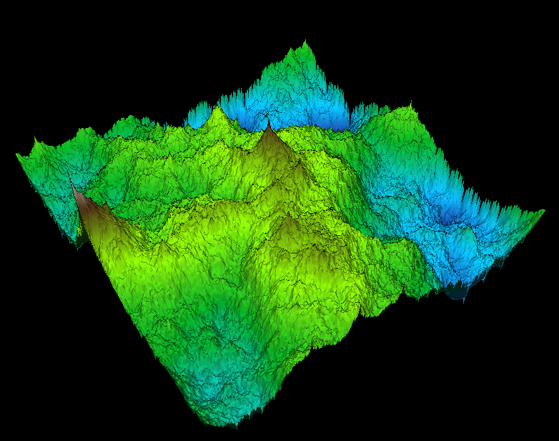
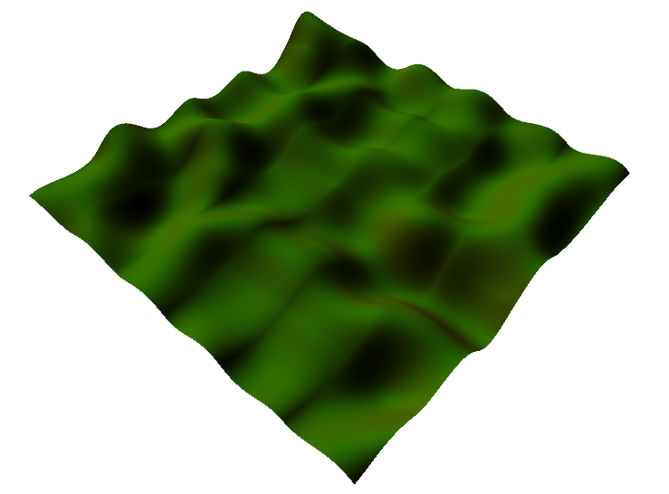
Terrain Generation
Fractal Landscape
Diamond-Square(Midpoint Displacement)
Perlin Noise

Slide 3
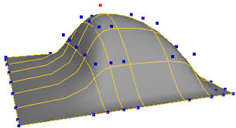
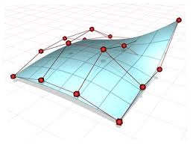
Terrain Generation
NURBS Surface
A mathematical model that offers great flexibility and precision for handling modelled shapes.
The generalization of B-spline, which in turn is the generalization of Bezier.
Defined by derivable formula

Slide 4
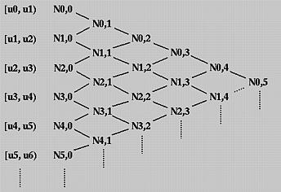

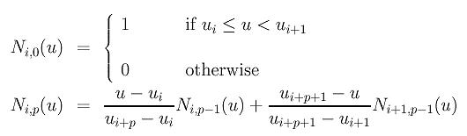
NURBS Definition
B-spline Curve
Basis Function

Slide 5

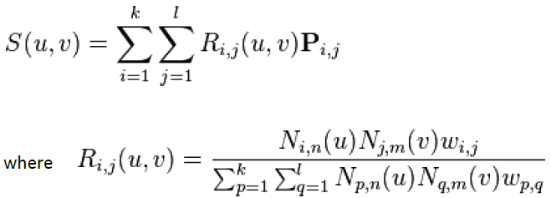
NURBS Definition
NURBS Curve
NURBS Surface

Slide 6
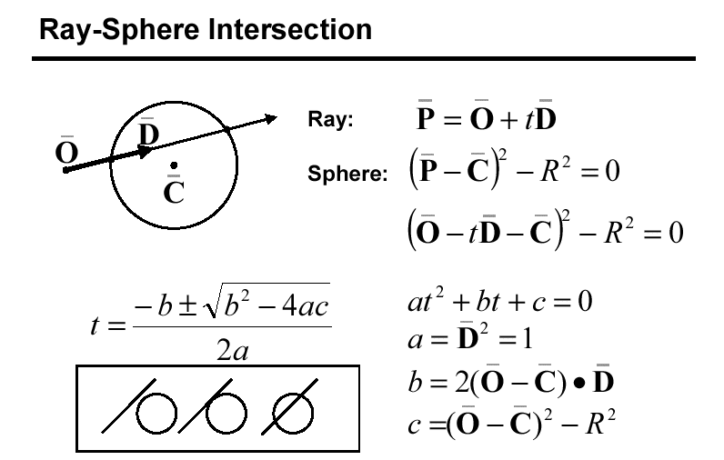
Control Point Manipulation

Slide 7
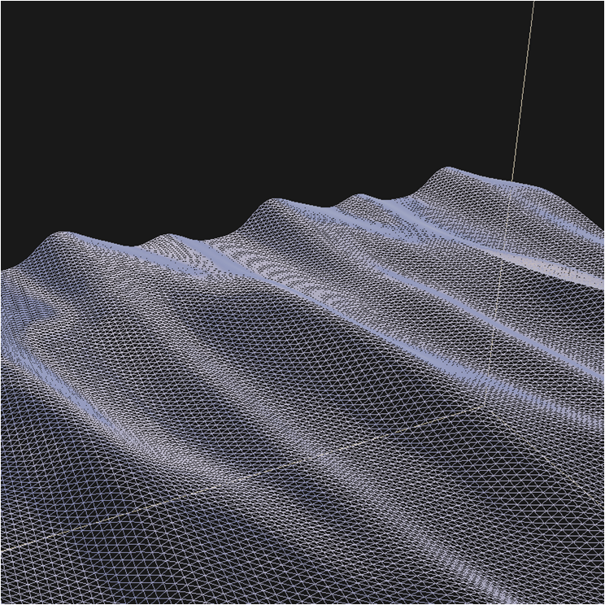
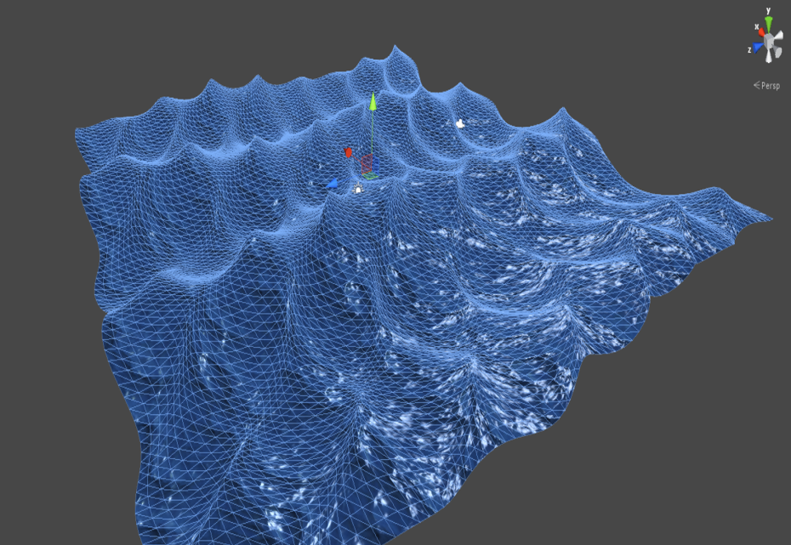
Water Simulation Techniques
In specific to the domain of water simulation, the summation of sine wave is the simplest and straight forward to implement because the geometric undulation of the surface mesh is easily represented by the sum of periodic waves.
Summation Sine Waves
Gerstner wave is extension of summation of sine waves but the approach offer a particular characteristic. This characteristic can be shown when forming sharper crest. Due to the nature of the Gerstner formula, it computes the displacement of the X and Z. This meant that the vertices move towards each crest so wave crests that are the sharpest have the highest frequency of polygon count.
Gerstner Wave

Slide 8
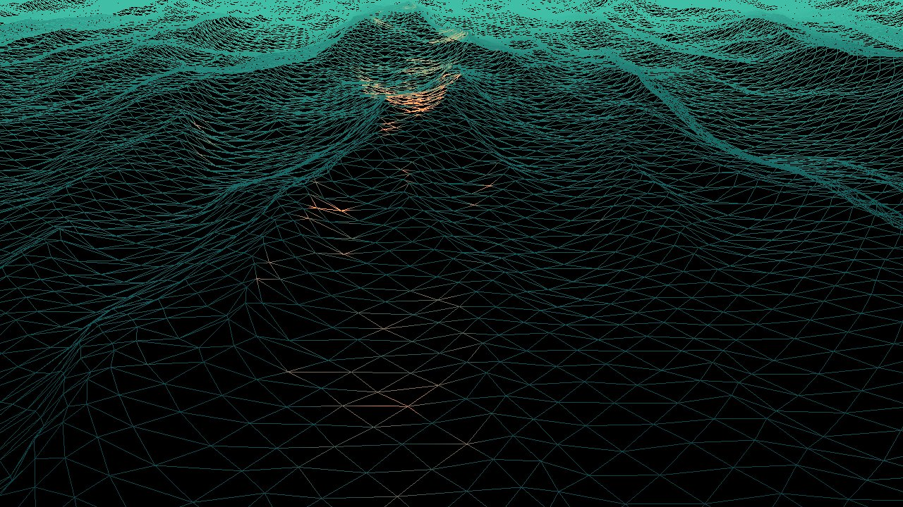
Water Simulation Techniques
The advantage of FFT is the flexibility to mimic and recreate any type of wave characteristic and its fast computational speed for calculating transforms. However computing FFT on CPU becomes the bottleneck when the displacement map gets larger. Large displacement map is a must-have for detailed wave crests.
Fast Fourier Transform

Slide 9
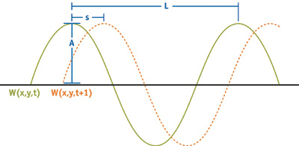
Summation of Sine Wave
The sum of sines gives a continuous function describing the height and surface orientation of the water at all points.
Parameters of a single wave function:
> Wavelength (L): The crest-to-crest distance between waves in world space. Wavelength L relates to frequency w as w = 2p/L.
> Amplitude (A): The height from the water plane to the wave crest.
> Speed (S): The distance of the crest moves forward per second. It is convenient to express speed as phase-constant , where = S x 2p/L.
> Direction (D): The horizontal vector perpendicular to the wave front along which the crest travels.

Slide 10

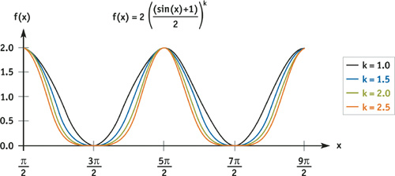
Good enough?
A common complaint about waves generated by summing sine waves directly is that they have too much "roll," that real waves have sharper peaks and wider troughs. As it turns out, there is a simple variant of the sine function that quite controllably gives this effect. We offset our sine function to be nonnegative and raise it to an exponent k.
Notes:
In our group project, we limit ourselves to four geometric waves. Adding more involves no new concepts, just more of the same vertex shader instructions and constants.

Slide 11
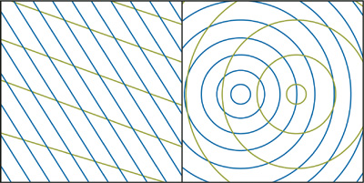
Directional or Circular Wave?
We have a choice of circular or directional waves. Directional waves require slightly fewer vertex shader instructions because circular waves, the direction must be calculated at each vertex and is simply the normalized vector from the centre of the wave to the vertex. Otherwise the choice depends on the scene being simulated.
For large bodies of water, directional waves are often preferable, because they are better models of wind-driven waves. For smaller pools of water whose source of waves is not the wind (such as the base of a waterfall), circular waves are preferable. Circular waves also have the nice property that their interference patterns never repeat.

Slide 12
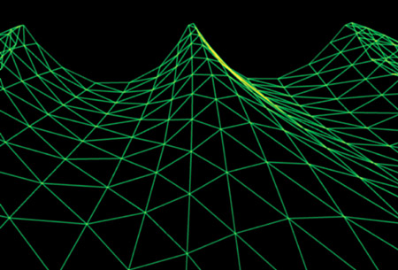
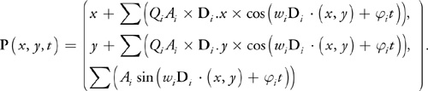
Gerstner Wave
For effective simulations, we need to control the steepness of our waves. As previously discussed, sine waves have a rounded look to them—which may be exactly what we want for a calm pond. But for rough seas, we need to form sharper peaks and broader troughs.

